Slide 1
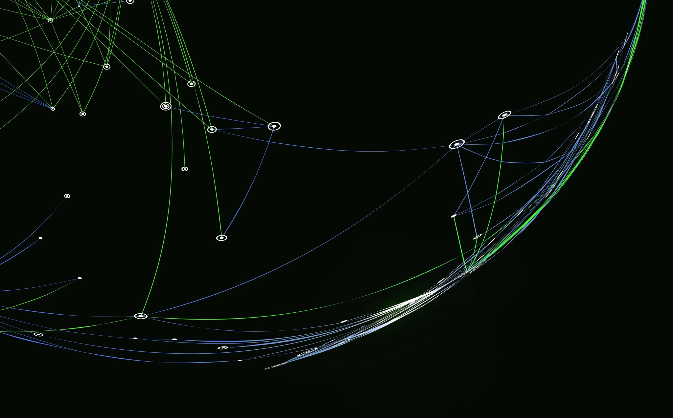
Game Mechanics Balancing using Reinforcement Learning
Alex Sharpe

Slide 2
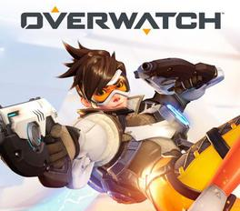
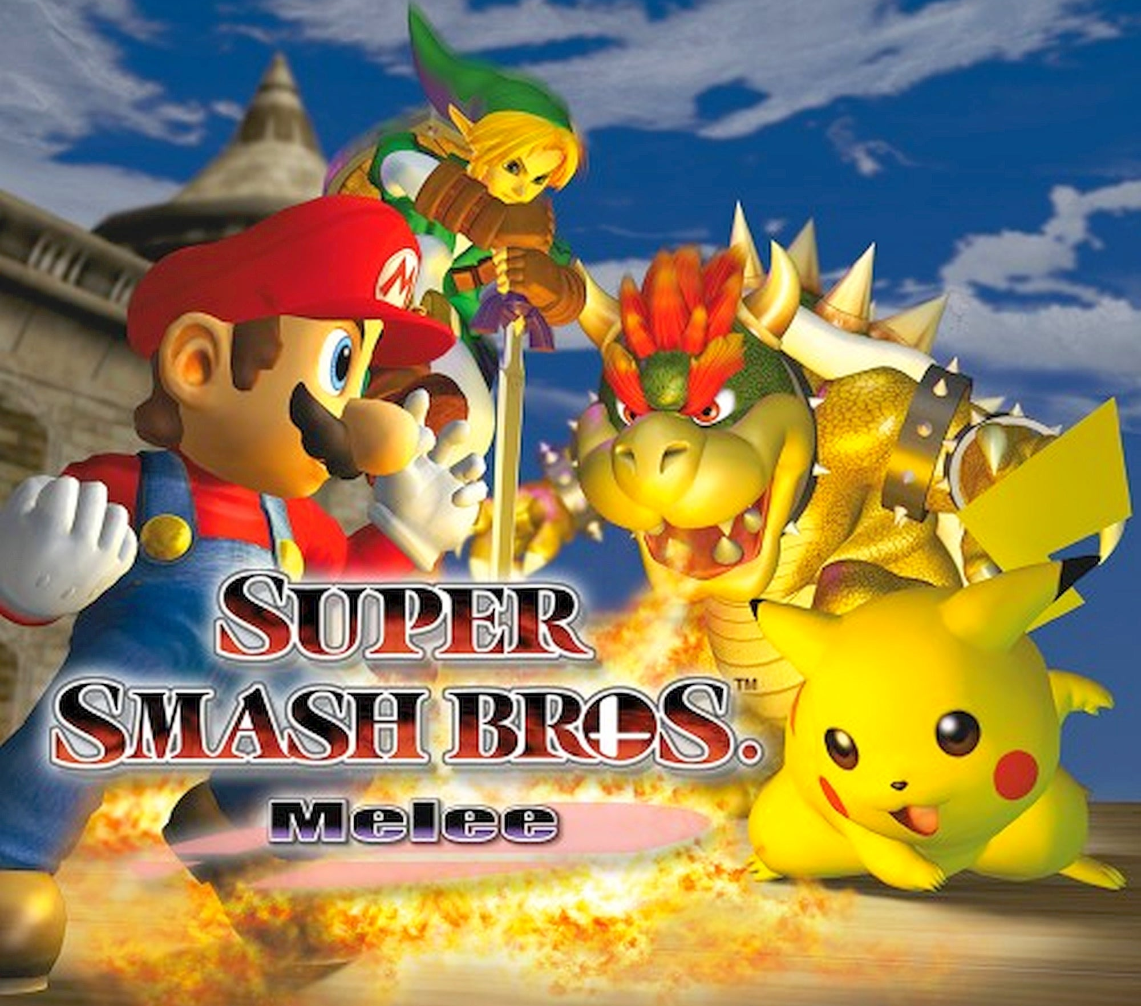
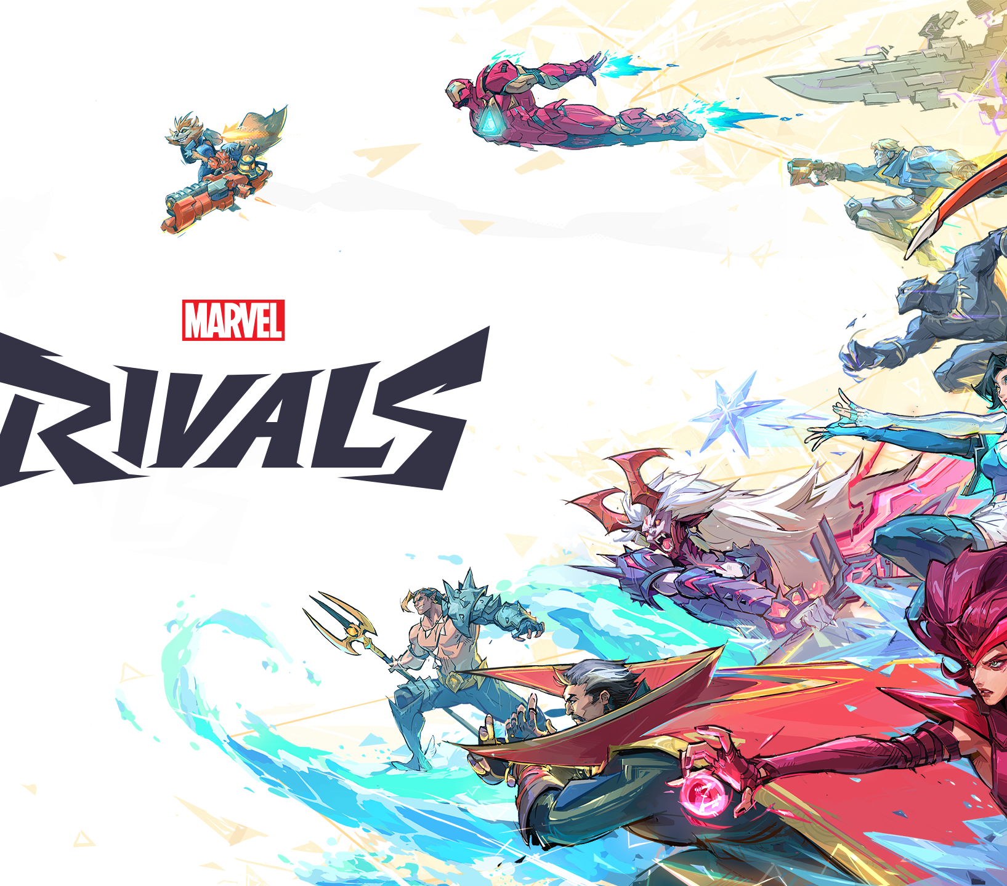
Video Games
Notes:
By a show of hands, who here plays video games? For those who do, how many of you have a game you want to love, but it’s so unbalanced that you can’t get past the “meta” to actually enjoy it? If your hand is still raised, the experiment I’m about to propose may be of interest to you. Many otherwise great games are consumed by an unfun or dominant meta that drives away players who simply want to enjoy the experience.
My name is Alex Sharpe. I am a long-time gamer and hold a Bachelor’s degree in Game Design from UCCS. I have also been on the development team for three separate games and have been directly involved in the balancing process for each of them.
Today, I will propose the application of Reinforcement Learning in Game Balancing for non-grid-based applications, including but not limited to frame data, damage calculations, and build variety.
(Now that we’ve covered the basics, lets begin with the why of this research: what is game balancing and why is it so important.)

Slide 3
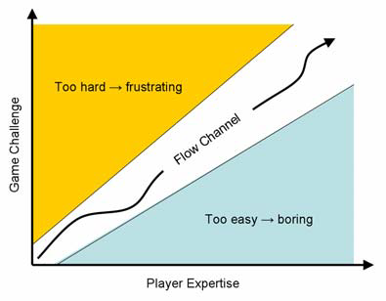
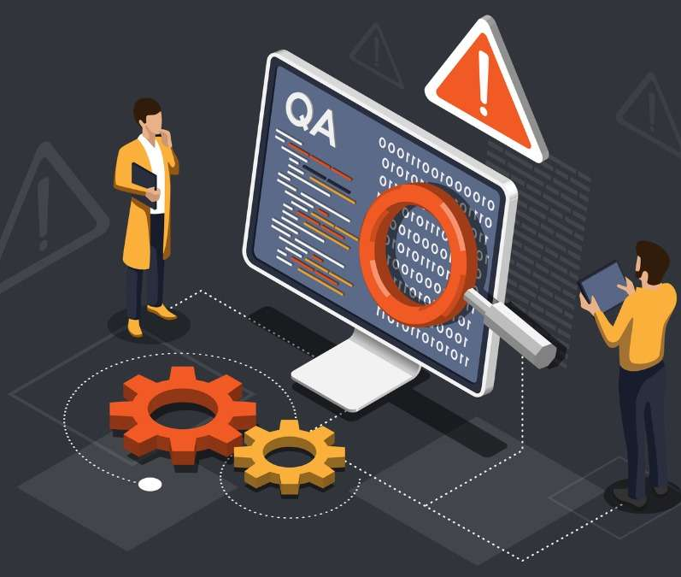
Game Balancing
Notes:
Game balancing is a task that all game studios must complete prior to release if they want a successful product.
Game balance determines factors such as animation timing, player statistics, equipment values, action properties, and the lethality and variety of enemies.
Good balancing is often invisible. Players simply play how they prefer and encounter a comparable level of difficulty regardless of playstyle.
Poor balancing can discourage players from engaging with a game they would otherwise enjoy. This often happens when there is only one “correct” way to play, or when the most effective strategy dominates the experience.
While balancing occurs continuously throughout development, the final two to six months are often heavily focused on quality assurance, including bug fixing and iterative balance testing.
During this phase, hundreds or even thousands of man-hours are spent repeating simulations, adjusting one variable at a time, and observing the resulting changes.
(That process should sound familiar—it closely resembles the core loop of a Reinforcement Learning algorithm.)

Slide 4
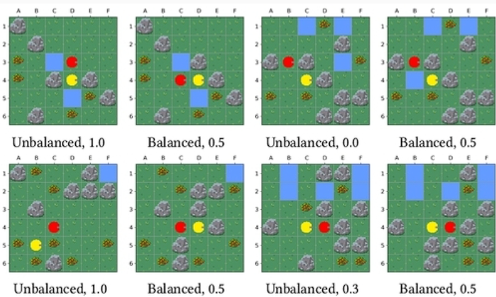
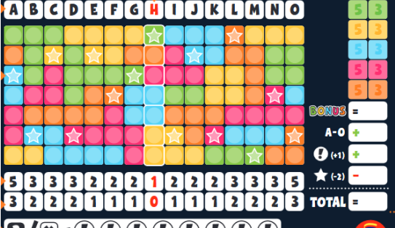
Reinforcement Learning Applications
Level the Level
Noch Mal!
Notes:
As you all know, Reinforcement Learning is the application of an autonomous agent towards learning to complete a task, and in the case of the Markov Decision Making framework, it involves learning how to complete this task from taking random actions.
Reinforcement learning has been used for Game Balancing in several papers from the last few years.
Eckert and Rupp explored its use in asymmetric map balancing, where agents with different capabilities should still have comparable win rates under equal skill assumptions. They focused on balancing spawn locations on a limited map rather than the mechanics of the game itself.
Lackner and Musliu applied Reinforcement Learning to balancing the board game Noch Mal! by modifying tile placement to promote strategic diversity. Their system accounted for non-determinism, since dice rolls determined available actions each turn.
Both studies demonstrated that the repetitive process of modifying a value and evaluating its impact aligns naturally with the reinforcement learning framework, particularly in grid-based environments.
A logical extension of this work is applying the same methodology to non-grid-based systems, specifically those defined by numerical parameters such as frame timing and damage values.
The methodology would remain similar: two agents—or an agent and a human player—compete under fixed mechanics while policies are learned.
Once the agent develops a stable and competent policy, the researcher analyzes the distribution of chosen actions to determine whether certain options dominate.
If one does, the proctor changes a value either on the best action or the not-best actions, and the simulation is rerun to observe whether the imbalance decreases.
(With the purpose and background established, we can now move to the implementation details.)

Slide 5
States and Actions
States
Frames as states
Distance, availability, health, etc.
Actions
Move backwards
Move forwards
Light attack
Heavy attack
Special attack
Block
Wait
Notes:
This experiment will take place in a simple, custom 2D fighting game.
The agent will treat each frame of the game as a state. At 60 frames per second, the agent observes the environment and extracts structured information such as relative distance, action availability, animation progress, and health values for both characters.
The action space will be intentionally limited to seven discrete actions: move forward, move backward, light attack, heavy attack, special attack, block, and wait. The special attack will bypass block, and block will reduce incoming damage by a fixed percentage.
The reward structure will consist of immediate rewards and terminal rewards. The agent will receive positive immediate reward for damage dealt and negative immediate reward for damage received. Additionally, a larger terminal reward will be granted for winning the match and a penalty for losing.

Slide 6
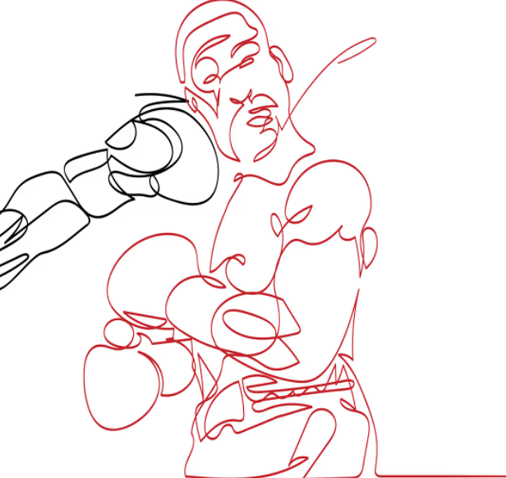


R = α·(damage dealt) − β·(damage received)
Aggressive
Neutral
Defensive
Where α > β
Where α = β
Where α < β
Notes:
Multiple agents will be trained using identical policies and states but with different reward weightings. This reward function will be defined as R = α·(damage dealt) − β·(damage received). An aggressive agent will use α > β, a defensive agent will α < β, and a neutral agent will use α = β.
Under this formulation, the aggressive agent will be more willing to trade damage to secure offensive pressure. The defensive agent will prioritize avoiding damage and will favor safer or lower-risk actions.
All agents will receive identical terminal rewards to ensure comparability of win conditions across playstyles.
One potential concern is overfitting between specific agents. If an aggressive and defensive agent train exclusively against each other, they may learn to exploit each other’s biases rather than the mechanics themselves. To mitigate this, evaluation should include cross-play against previously saved policies, randomized behavior, or even live players to give a varied sample set.
After agents reach a high level of competence, their learned policies will be frozen. Additional evaluation episodes will then be run. Every 100 episodes, action frequency and win rates will be analyzed. If one action is disproportionately selected and strongly correlated with success, its parameters will be reviewed. For example, if the heavy attack is underused because its windup frames make it too interruptible, its windup may be reduced slightly before re-evaluation.
The parameters available for every move to change will be the following: windup frames, active/execution frames, and recovery frames. Additionally, attacks will be able to adjust damage dealt, movement will be able to adjust distance, and block will be able to adjust damage absorbed (in %). The wait action will remain fixed.
To ensure that the results are meaningful, statistical tracking will be essential. Win rates, action usage frequency, average damage per action, and time-to-victory will all be recorded. This prevents balancing decisions from being based solely on action frequency and instead grounds them in measurable performance metrics. For example, an action may be used frequently but not produce disproportionate advantage, which would not necessarily indicate imbalance. By combining frequency and outcome data, the balancing process becomes more systematic and less subjective.
(Before we conclude, let’s talk about what this experiment will not be capable of if it is successful.)

Slide 7
What this won’t do
Eliminate
Eliminate human QA testing
Determine
Completely determine final numbers
Override
Override “gut feelings.”
Notes:
Firstly, this will not eliminate the human component of QA testing
Human interaction will still be necessary before and after this process, both to get initial values and focus on final ones. In practice, this system could operate overnight during development, running thousands of simulated matches while designers review summary statistics the next morning. Rather than replacing designers, it would accelerate the balancing process by doing the tedious, repetitive part off the clock.
As such, this technique will not be used to completely determine the final statistics behind actions taken. While balance is important, an over-balanced game can feel homogenized and boring.
Finally, sometimes the developer will have a “gut feeling” about how a move should be balanced. Ignoring the statistics and going with what sounds fun happens often in game design, and in such cases, this technique would serve as a diagnostic tool rather than an absolute authority.
(Now, to summarize this experiment and field some questions regarding it.)

Slide 8
Conclusion
Notes:
Today I discussed the possibility of using a Reinforcement Learning Algorithm to balance game mechanics, specifically in the realm of balancing actions in a fighting game.
The next time you play a game overtaken by the meta or made unfun by a new character that just released, imagine how much better it might’ve been if they took the time and proper technique to balance it appropriately.
Imagine a world where games not only release faster, but are more polished and accessible to everyone: because that sounds like a bright future to me.

